Slide 1
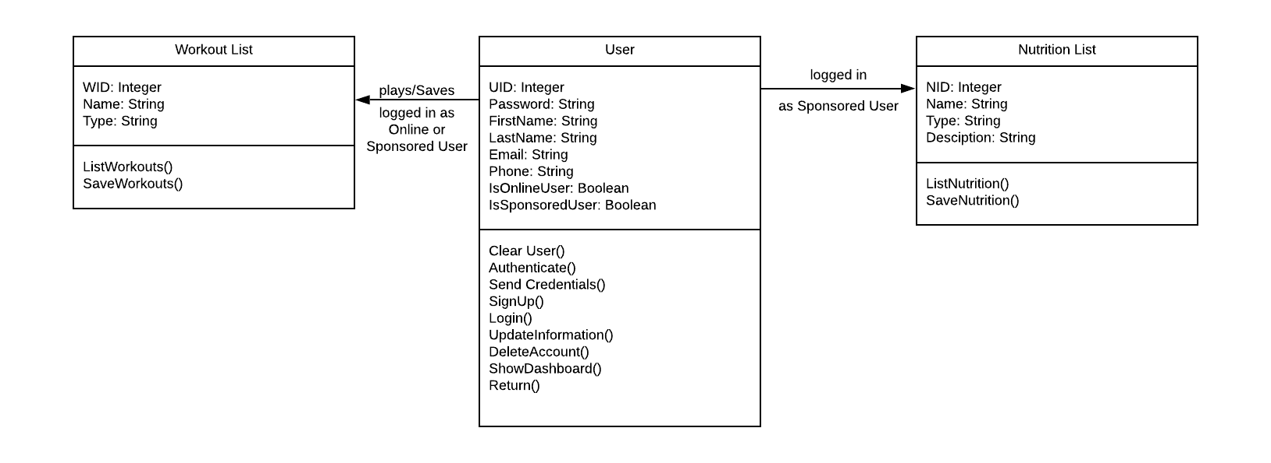
Class Diagram (UnitFit)

